Slide 1
An Introduction To Phylodynamics
Conor Meehan (he/they)
conor.meehan@ntu.ac.uk
@con_meehan

Slide 2
Learning outcomes
Recognise the Monte Carlo Markov Chain process
Describe some common Bayesian epidemiology priors
State the molecular clock hypothesis
Describe the coalescent and its use for estimating population dynamics
Identify the origins of a new pathogen using phylogenetics
Recognise the approaches used to determine transmission dynamics of pathogens

Slide 3
How to read a WGS phylogenetics methods section
Four decades of transmission of a multidrug-resistant Mycobacterium tuberculosis outbreak strain Eldholm et al. Nature Communications (2015)
In BEAST, rates were modelled using the GTR substitution model of evolution and variation among sites was simulated using a discrete gamma distribution with four rate categories. We further assumed a lognormal relaxed clock to allow variation in rates among branches in the tree. The tree was calibrated using tip dates only with sample time span ranging from October 1996 to December 2009.
For each analysis we ran four independent chains in which samples were drawn every 5,000 MCMC steps from a total of 50,000,000 steps, after a discarded burn-in of 5,000,000 steps.
Yellow sections covered in optional models of evolution lecture
Blue sections explained here

Slide 4
Parametric methods of phylogenetic inference
Parametric methods take a column in an alignment and calculate the optimality criterion per site
Sites are independent
An explicit model of evolution is required
Can incorporate rate heterogeneity
There are two main parametric methods of phylogenetic inference:
Maximum likelihood
Bayesian analysis
Both methods search tree space to find the best tree

Slide 5
Bayesian analysis
Often used to build time trees where branch lengths correspond to a certain length of time
Can give estimate of tree phylogeny and other parameters
Divergence date/location
Rate of speciation/extinction
Incorporates existing knowledge into the data (priors)
Gives a posterior probability that the hypothesised tree is true, given the observed data and priors
Posterior probabilities serve as reliability measure
Example programs: BEAST/BEAST2, MrBayes/RevBayes, PhyloBayes

Slide 6
Bayesian analysis (MCMC)
Each cycle is a step in a Monte Carlo Markov Chain (MCMC)
Must assess for convergence to see if the cycles are finding the same answer repeatedly and thus can be stopped
See worksheets
The tree topology and parameters that were visited the most (i.e. present in the most states) are output as the optimal phylogeny etc.
The posterior probablity is the proportion of cycles that branch was found in (between 0 and 1)

Slide 7
Bayesian priors
If we have prior knowledge that applies to the data, we can incorporate this into the model
Sampling dates
Model of evolution
Fossil dates
For instance we may have a dataset of an outbreak that started in 2009 and we can limit the estimates of transmission dates on a tree to be >2009
These help guide the process through tree searching space
Wrong priors give wrong estimates
Can/Must also incorporate evolutionary/population processes into the model
Time trees requires a molecular clock model
Population size estimates require a population model
Can also test which is appropriate within the framework

Slide 8
Tasks 1
What can Bayesian analyses estimate that other methods such as ML cannot?
What does the posterior probability represent?
Give an example of a prior you may input for molecular epidemiology analyses.

Slide 9
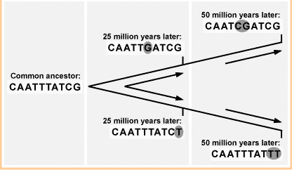
Molecular clock
Assumed that there is a stocastic relationship between time and the rate of mutation of a gene
If we know this rate, we can correlate it to changes through time and estimate a divergence time
http://evolution.berkeley.edu/evosite/evo101/IIE1cMolecularclocks.shtml

Slide 10
Strict versus Relaxed
Strict:
One rate of mutation for every branch in tree
Relaxed
Different rate for each branch
Correlated:
Rates influenced by the rate of the parent branch
Uncorrelated
Rates independent
R₁
R₁
R₁
R₁
R₁
R₁
R₁
R₁
R₅
R₃
R₆
R₂
R₇
R₄
R₈
R₁

Slide 11
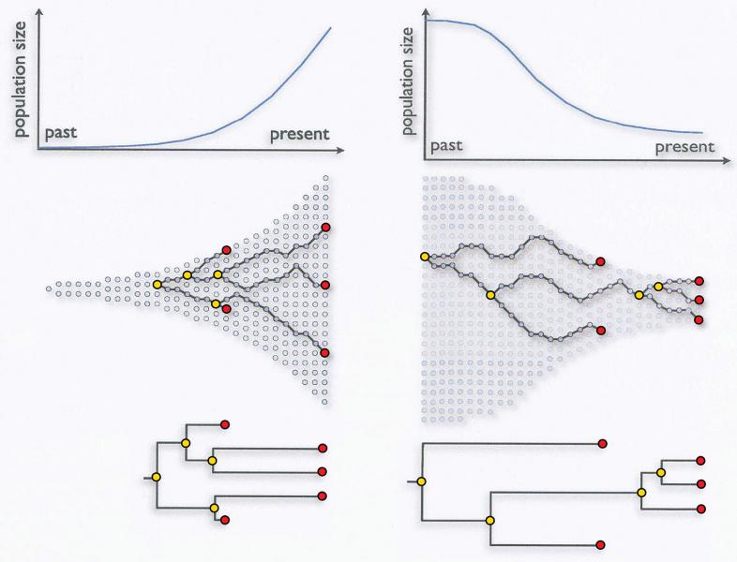
Coalescent
A model of population evolution
When two alleles/individuals come together to form an ancestor (i.e. two branches meet) this is called a coalescent event
Sainani Biomedical computation review (2009)

Slide 12
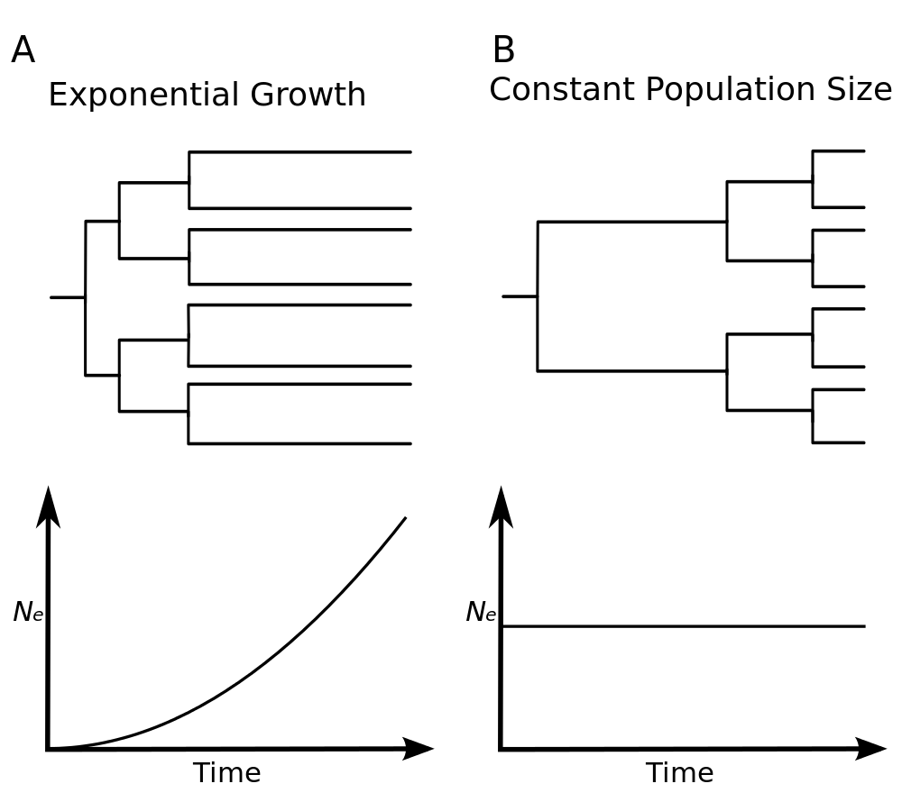
Coalescent
Exponential:
Suitable for early samples
Constant:
Population is stable from MRCA to current time
Volz et al. PLoS comp bio (2008)

Slide 13
Estimating population changes
Population sizes can be estimated from phylogenetic data
Split time tree into intervals between coalescent events
Population size calculation
N_{i} = γi(i-1)/2
γ is the interval length
i is number of lineages in interval
Bayesian skyline plot
Estimates phylogeny and population size simultaneously
Also done in Skyride and Skygrid
Ho & Shapiro, Mol Ecol Res 2011

Slide 14
How to read a WGS phylogenetics methods section
Four decades of transmission of a multidrug-resistant Mycobacterium tuberculosis outbreak strain Eldholm et al. Nature Communications (2015)
In BEAST, rates were modelled using the GTR substitution model of evolution and variation among sites was simulated using a discrete gamma distribution with four rate categories. We further assumed a lognormal relaxed clock to allow variation in rates among branches in the tree. The tree was calibrated using tip dates only with sample time span ranging from October 1996 to December 2009.
For each analysis we ran four independent chains in which samples were drawn every 5,000 MCMC steps from a total of 50,000,000 steps, after a discarded burn-in of 5,000,000 steps.
Yellow sections covered in optional models of evolution lecture
Blue sections explained here

Slide 15
Tasks 2
What are the two main types of molecular clock?
What is a coalescent event?

Slide 16
Break

Slide 17
Determining the origin

Slide 18
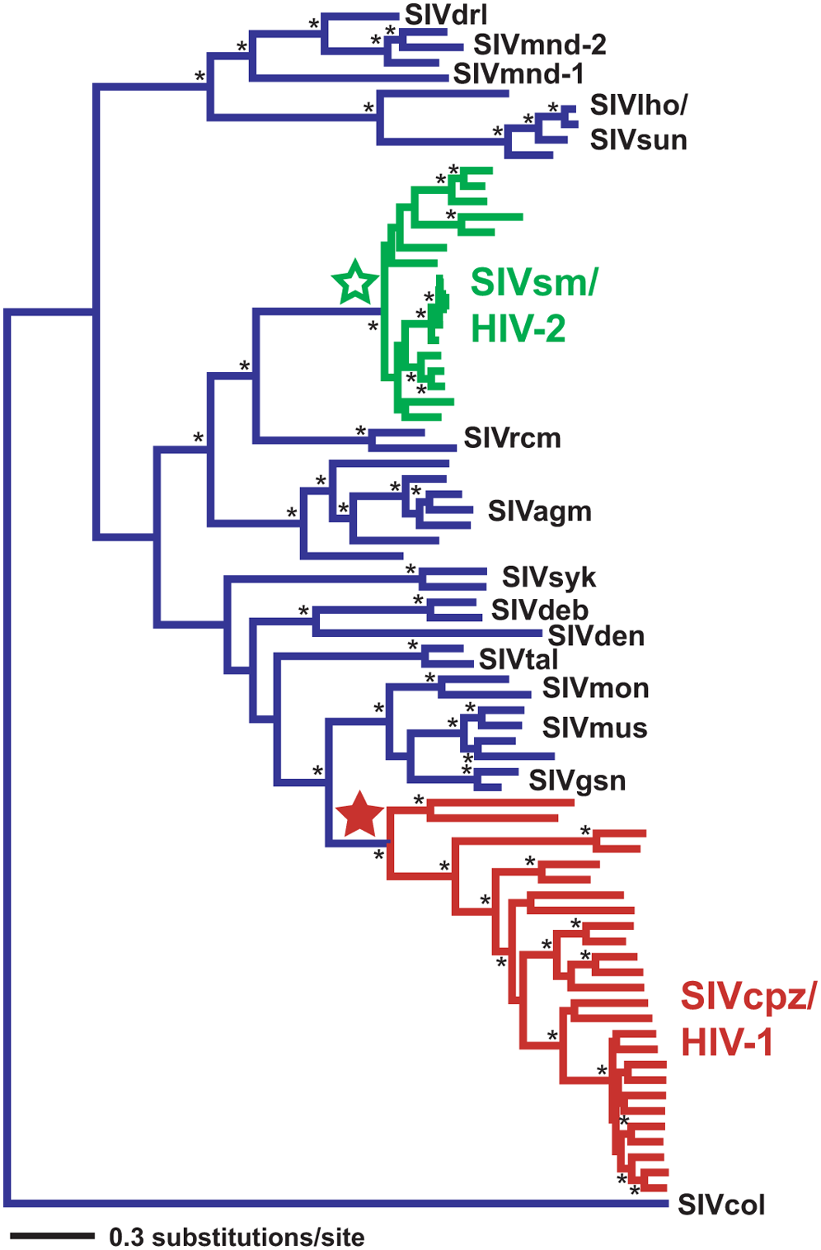
Where did HIV come from?
Lentiviruses are known to infect several species of primates in sub-Saharan Africa
Tree constructed containing sequences from SIV and both HIV-1 and HIV-2
HIV-1 likely arose in western equatorial Africa
HIV-2 likely arose in West Africa
Primarily confined there too
Wertheim and Worobey, PLOS Comp Bio 2009

Slide 19
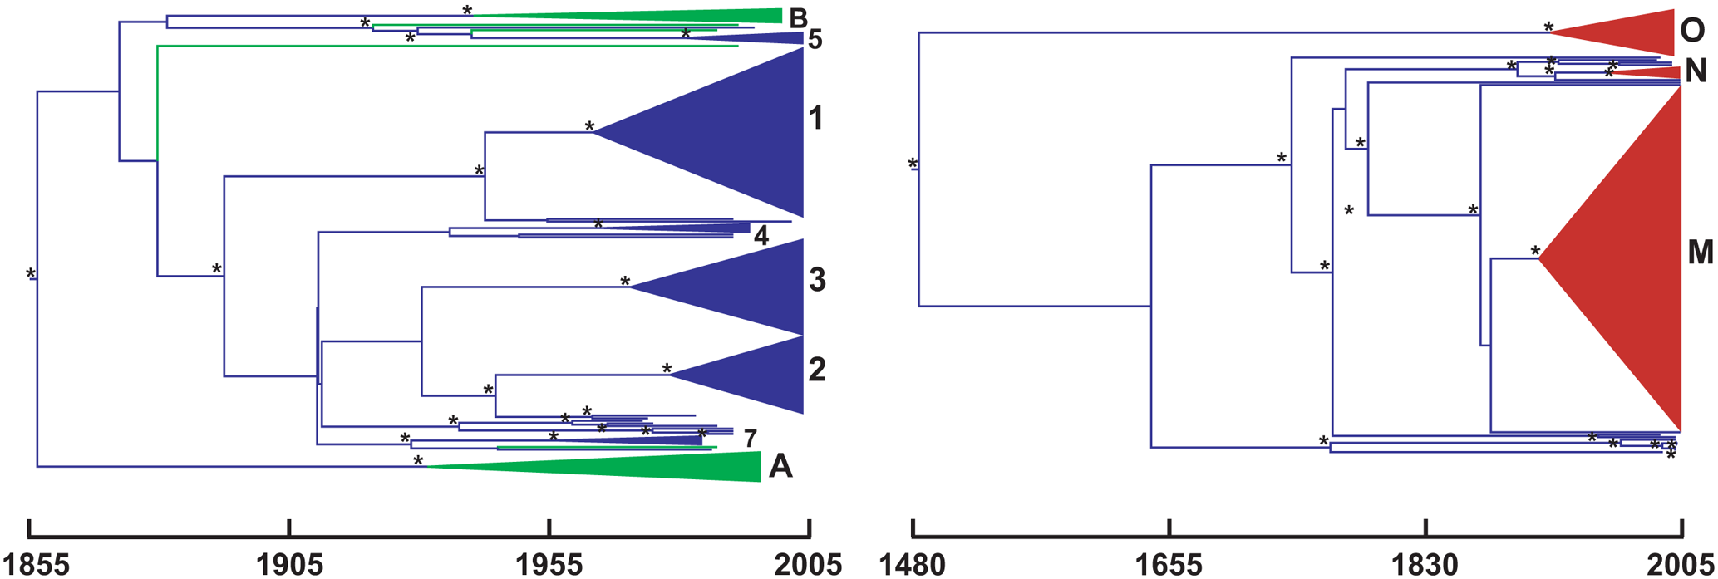
When did HIV get to humans?
Early estimations of HIV-1 divergence from SIVcpz dated this event as ~1960 (Li et al 1988, Mol. Biol. Evol.)
Reanalysis found that this estimation used too simple a model of nucleotide sequence evolution
HIV analysis usually estimated under the GTR or SRD06 model
Dates spread throughout early 20th century
Wertheim and Worobey, PLOS Comp Bio 2009

Slide 20
How did HIV get to humans?
An early hypothesis, outlined in ‘The River’ by Edward Hooper (1999) suggested a a contaminated oral polio vaccine (OPV) used in the 1950’s
The other leading hypothesis is that blood-to-blood transmission occurred from butchered primate meat to hunters
Molecular evidence was gathered by Sharp et al (2001, Phil. Trans. R. Soc. Lond. B) to review these claims
OPV trial chimpanzees were not the same as those suggested to be resevoir for SIV
The origins were dated as ~1931, not 1950’
Although the bush meat hypothesis cannot be directly proven, phylogenetic and molecular analysis lend strong support against the OPV hypothesis

Slide 21
Estimating historical dynamics

Slide 22
Hepatitis C
Cause of liver disease and cirrhosis
Caused by the Hepatitis C virus (HCV)
130-200M infected worldwide
~700,000 deaths a year
Blood to blood contact
Unsterilized equipment

Slide 23
Hepatitis C
Hepatitis C virus (HCV) has a high prevalence in Egypt
Suggested this is due to unsterile injections during mass treatment with parenteral antischistosomal therapy from 1920s to 1980s
63 partial E1 gene sequences from 1993
Suitable for coalescent analysis because:
Geographically diverse
Random sampling
No obvious population subdivisions
Ample phylogenetic information
Independent estimate of model of evolution
Bayesian skyline population model applied
Estimate population sizes back in time
Drummond et al. Mol Biol Evol 2005

Slide 24
Hepatitis C
Origins of a pathogen
What host did it jump from?
When did it jump?
Local transmission
Who infected whom?
Important need for controls
Global spread of epidemics
Where did it start?
What were the focal points of transmission?
Population dynamics
Population size changes over time

Slide 25
Estimating local transmission dynamics

Slide 26
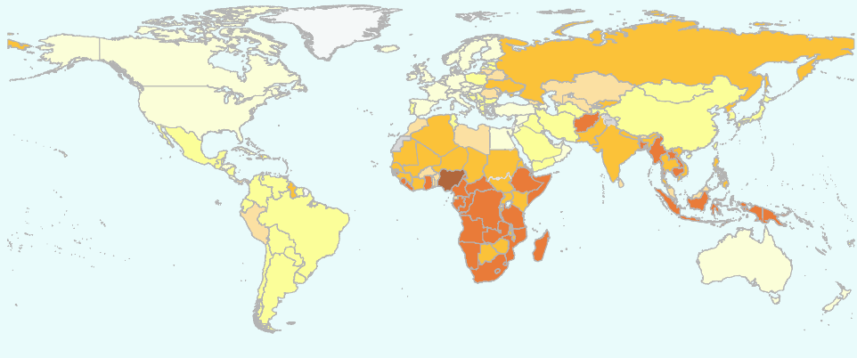
Mycobacterium tuberculosis
Causative agent of TB
~1/3 of the world (supposedly) infected
Transmitted by aerosols
Close contact between people
Long latency before active disease
Transmission important in drug resistance
Transmission > point mutations
Some multidrug resistant (MDR) strains circulating for decades

Slide 27
RR-TB in Rwanda
Rifampicin resistant tuberculosis
Must be treated with second line drugs
Large issue in clinical and public health management
308 whole genome samples of RR-TB in Rwanda
1991-2018
What amount of RR-TB is due to transmission?

Slide 28
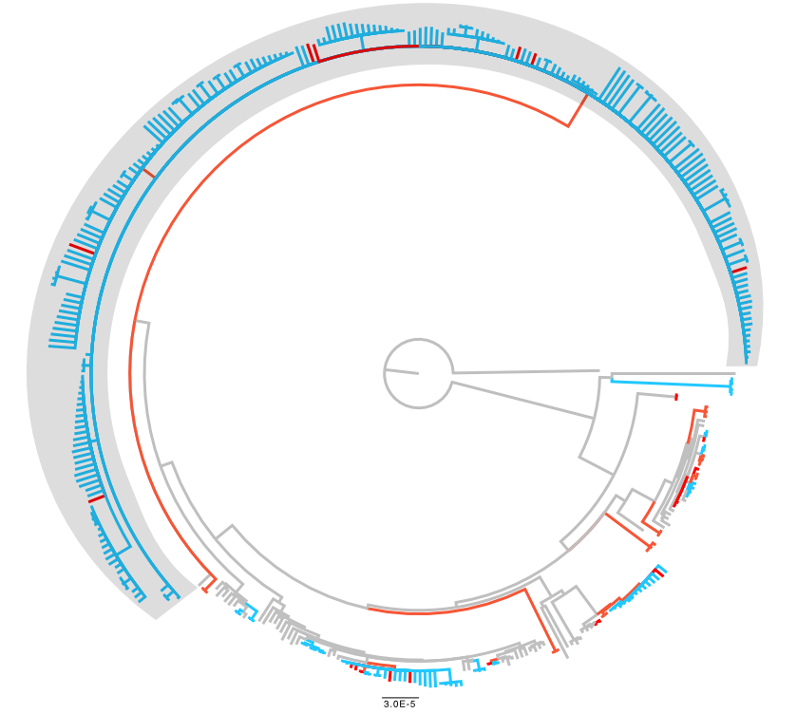
Rwanda RR-TB driven by a single transmission cluster
5 SNP transmission cluster sin blue
12 SNP clusters in red
One large transmission cluster (grey) driving RR-TB
When did it arise?
Who is transmitting?
Ngabonziza et al, JCTUBE, 2022

Slide 29
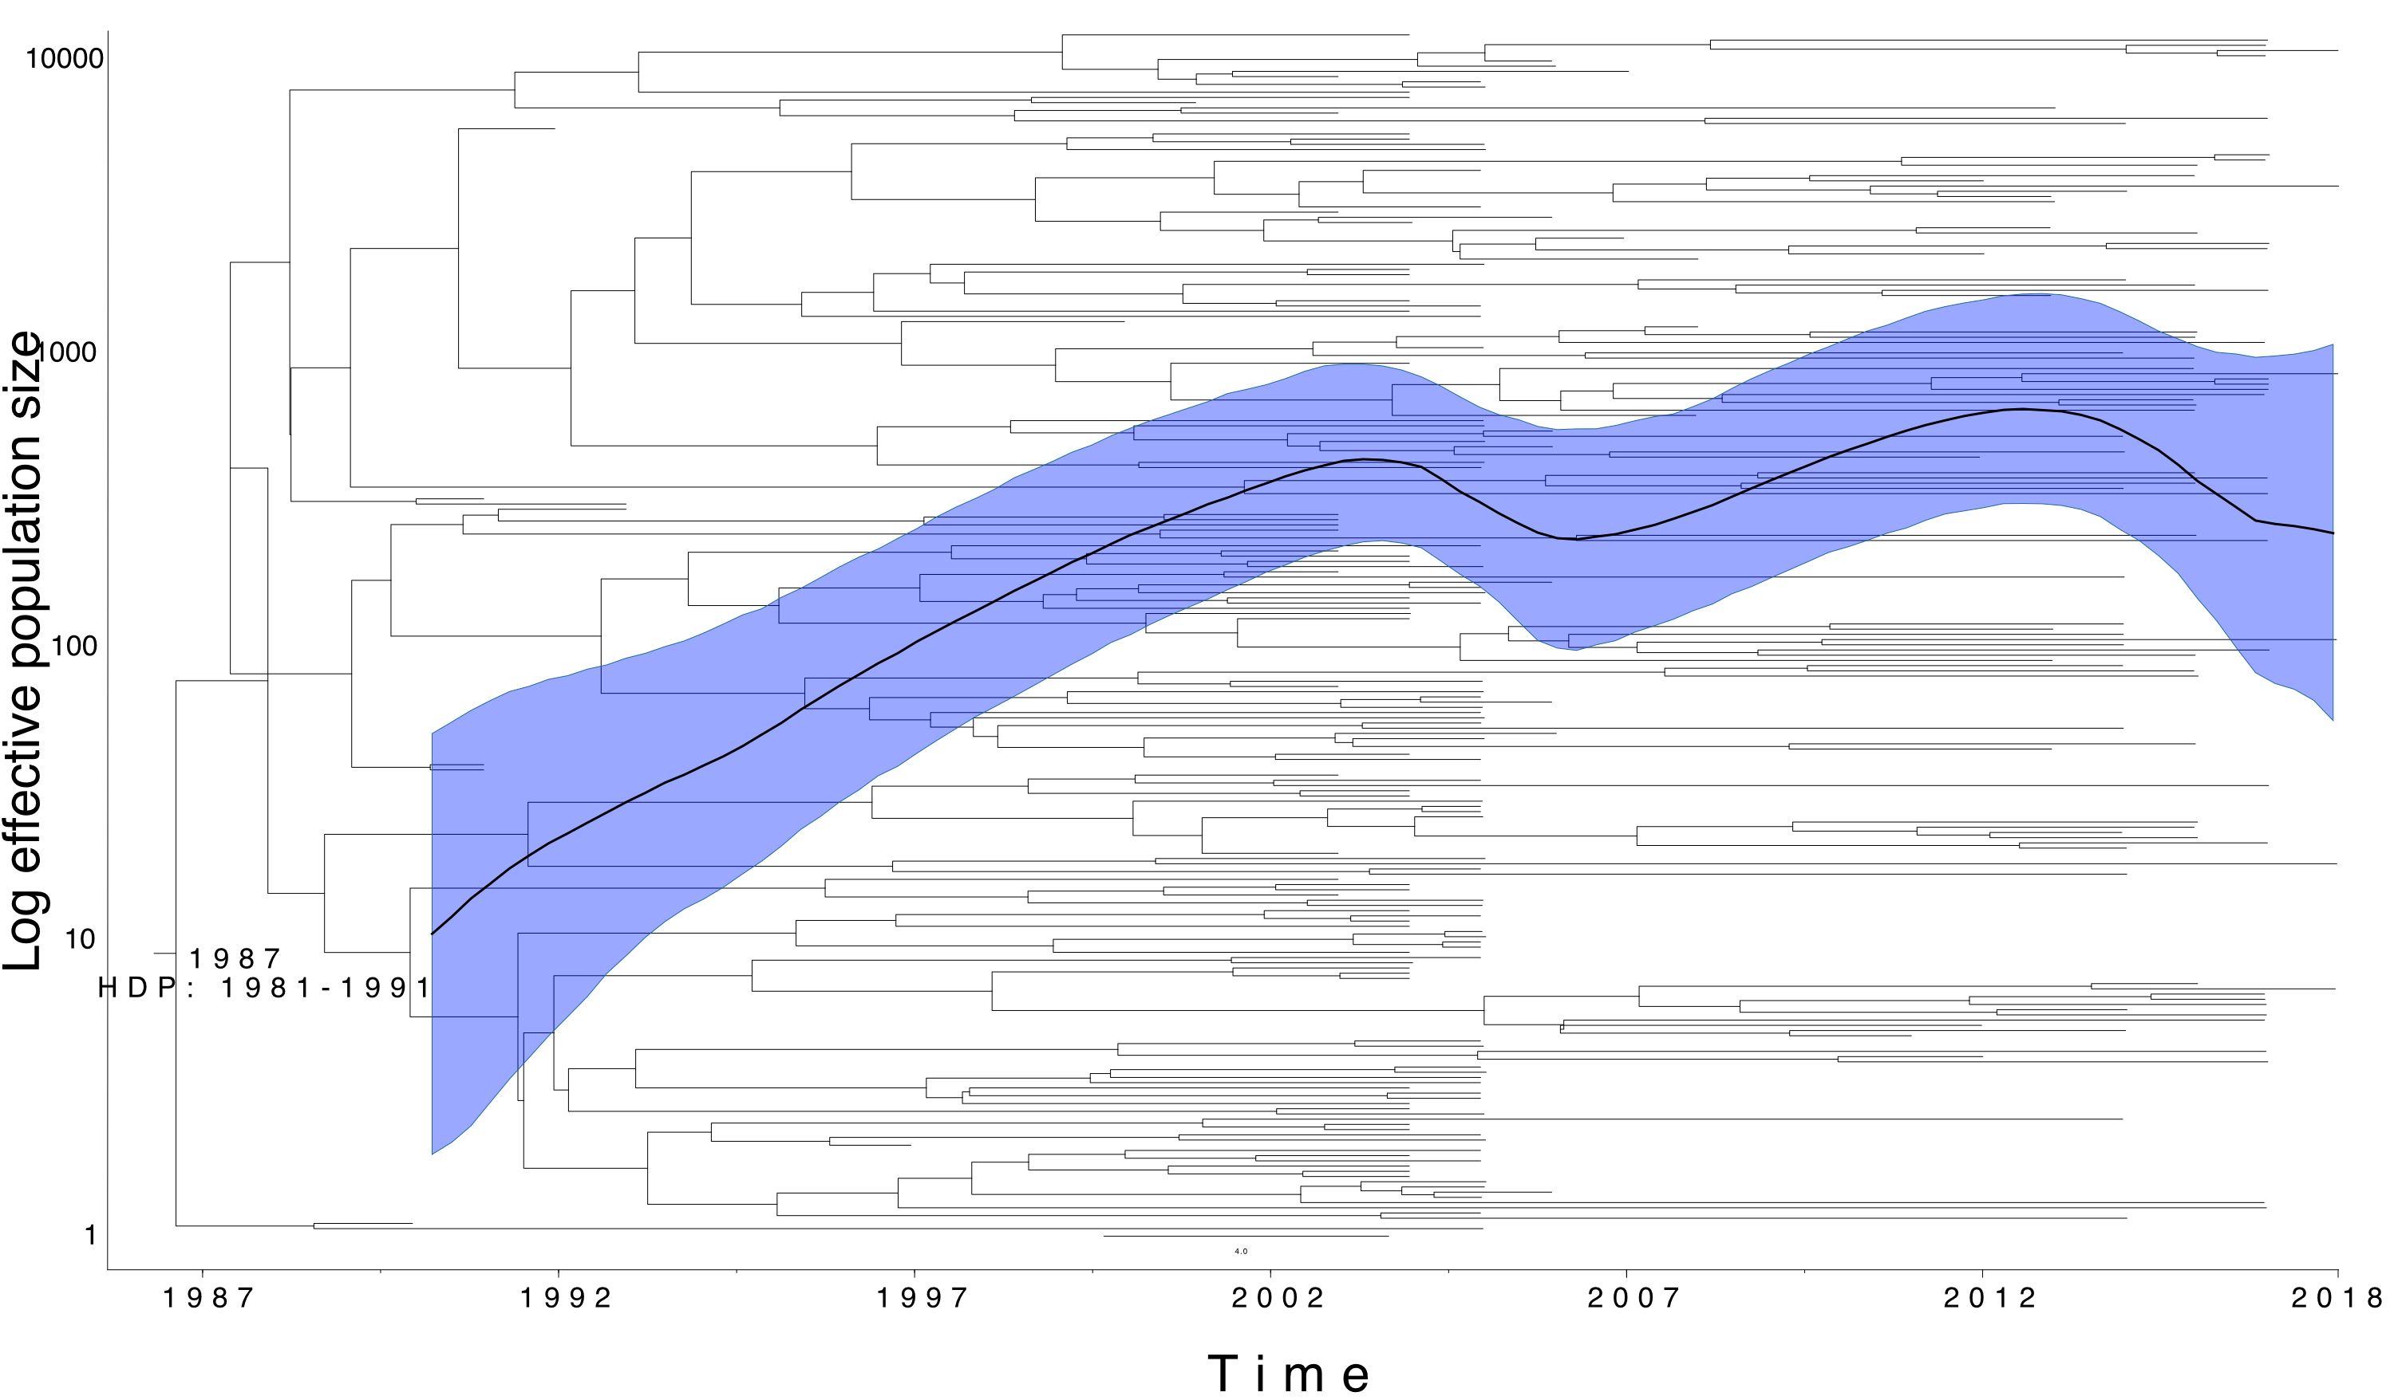
RR-TB cluster present since rifampicin introduced
Ngabonziza et al, JCTUBE, 2022

Slide 30
Transmission more likely in relapse cases
TransPhylo used to estimate secondary case contact rate
How many peoples does a an infected individual infect?
Primarily those in Category 2 (repeated treatment failures) that transmit this clone
Clinical management brings down transmission
Ngabonziza et al, JCTUBE, 2022

Slide 31
Estimating epidemic events

Slide 32
Tracking an influenza outbreak
The H1N1 (swine flu) influenza strain was first identified in April 2009
Within a few months it reached pandemic proportions
Phylogeographic analysis
Where did the outbreak start?
How and when did it spread?

Slide 33
Tracking an influenza outbreak
Lemey et al (2009), “Reconstructing the initial global spread of a human influenza pandemic” PLOS currents
242 sequences
HA and NA gene sequences
40 locations worldwide
30th March to 12th July 2009
Bayesian framework
HKY + gamma model
Relaxed molecular clock
BSSVS model of spatial diffusion
Bayesian stochastic search variable selection
7 discrete locations as priors
Allow MCMC to assign location probabilities to internal nodes

Slide 34
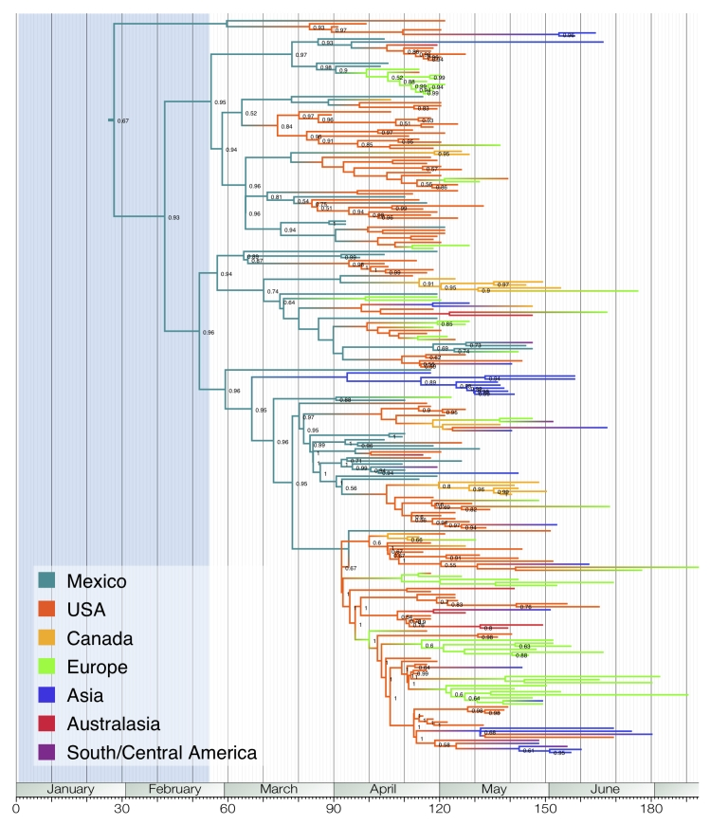
Tracking an influenza outbreak
Phylogenetic reconstruction indicates Mexico as the likely origin of the virus
Several USA strains were seeded early in the outbreak
Most European lineages came from USA strains, not Mexico
Lemey et al (2009). PLoS Curr.

Slide 35
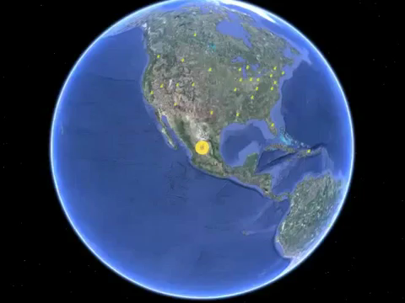
Tracking an influenza outbreak
Lemey et al (2009). PLoS Curr.

Slide 36
Microbial phylodynamics
Origins of a pathogen
What host did it jump from?
When did it jump?
Population dynamics
Population size changes over time
Local transmission
What is driving local epidemics?
Global spread of epidemics
Where did it start?
What were the focal points of transmission?

Slide 37
Tasks 3
What molecular evidence should be gathered to prove zoonitic transmission?
List 3 assumptions that need to be fulfilled to undertake population dynamic analysis
What kind of phylogenetic tree building approach is needed to incorporate location data into the process?

Slide 38
Learning outcomes
Recognise the Monte Carlo Markov Chain process
Describe some common Bayesian epidemiology priors
State the molecular clock hypothesis
Describe the coalescent and its use for estimating population dynamics
Identify the origins of a new pathogen using phylogenetics
Recognise the approaches used to determine transmission dynamics of pathogens

